Slide 1


Leveraging patient’s longitudinal data to predict mortality risk
October 13th, 2023
Acknowledgments:
Ryeyan Taseen
Jean-François Ethier
Authors:
Hakima Laribi
PhD student, Computer Science
Nicolas Raymond
M.Sc. BMath
Martin Vallières
Assistant Professor
medomics-udes.org

Slide 2
Disclosure of Financial Support
No External Support.

Slide 3
Faculty/Presenter Disclosure
Not applicable.

Slide 4
Learning objectives
The potential of routine admission data for predicting short-term and long-term mortality.
The potential of patients’ longitudinal data to improve the accuracy of mortality prediction.

Slide 5
Long-term patient mortality risk
Improve palliative and end-of-life care.
Initiate goals of care discussions with clinicians.
Short-term patient mortality risk
Stratify patients into risk categories for resource allocation.
Identify candidates for early interventions to reduce mortality.

Slide 6
Automated identification of patients with a high risk of mortality
One-year mortality risk
Baseline Model
One-year mortality prediction post-discharge
One-year mortality prediction during admission
One-year mortality prediction during and/or at admission
HOMR
mHOMR
RF-HOMR
[Walraven, 2014]
[Wegier and al., 2019]
[Taseen and al., 2021]
Omit diagnoses and some other variables
Two strategies: with and without diagnoses

Slide 7



Some patients have multiple visits to the hospital
In the literature, models addressing this issue:
Consider patient visits independently, and/or
Select a random visit per patient.
Visit 1
Visit 2
Visit 3
Temporal aggregation
Simulate a clinician's holistic consideration of a patient's history before making medical prognoses, diagnoses, or decisions.

Slide 8
Automated identification of patients with a high risk of mortality
In-hospital mortality risk
Patients admitted to the ICU and/or diagnosed with a specific medical condition.
To the best of our knowledge, has never been investigated using only routine admission data.

Slide 9
We propose to:
Investigate the capacity of routine admission data for in-hospital mortality prediction.
Utilize longitudinal patient data for one-year and in-hospital mortality predictions.
Evaluate two variable sets: without diagnoses (AdmDemo) and with diagnoses (AdmDemoDx).

Slide 10
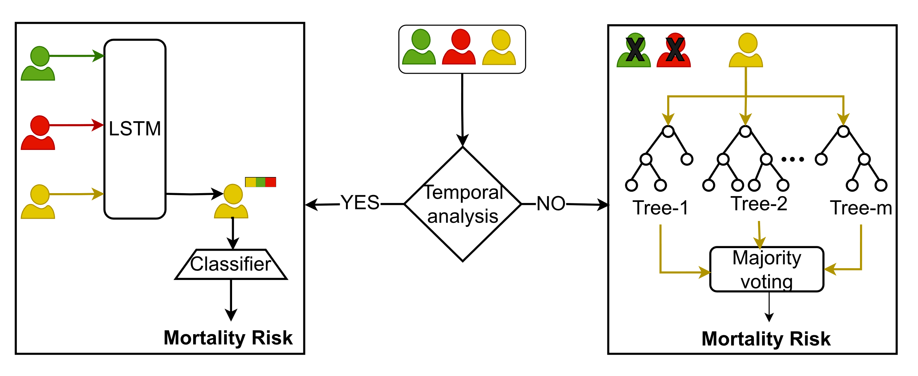
What do we want to compare?
What we suggest to do
What was previously done
Prediction at the patient’s last visit available
Long-Short Term Memory Neural Network (LSTM)
Random Forest (RF)

Slide 11
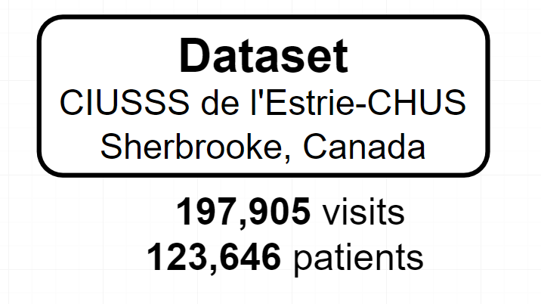
Dataset characteristics
Adult patients admitted to CIUSSS de l’Estrie-CHUS, Sherbrooke, Canada.
Admissions that occurred between mid 2011 to mid 2021.
Non-psychiatric admissions.
AdmDemo
Each visit has
Demographics | Admission characteristics | Admission diagnoses | Comorbidity diagnoses
AdmDemoDx
Taseen, R., & Ethier, J. F. (2021). Expected clinical utility of automatable prediction models for improving palliative and end-of-life care outcomes: Toward routine decision analysis before implementation. Journal of the American Medical Informatics Association, 28(11), 2366-2378.

Slide 12
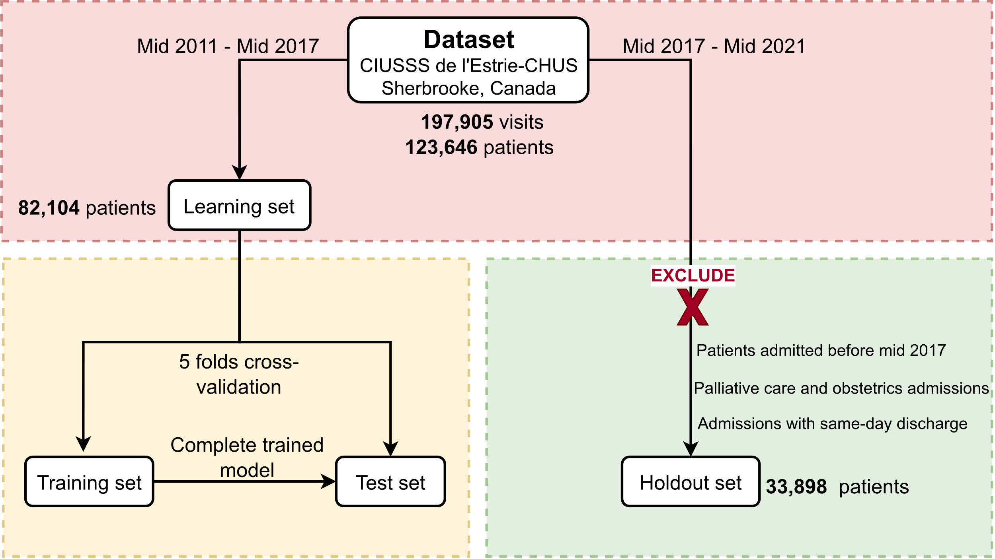
RF vs LSTM?
Development phase
Deployment phase

Slide 13
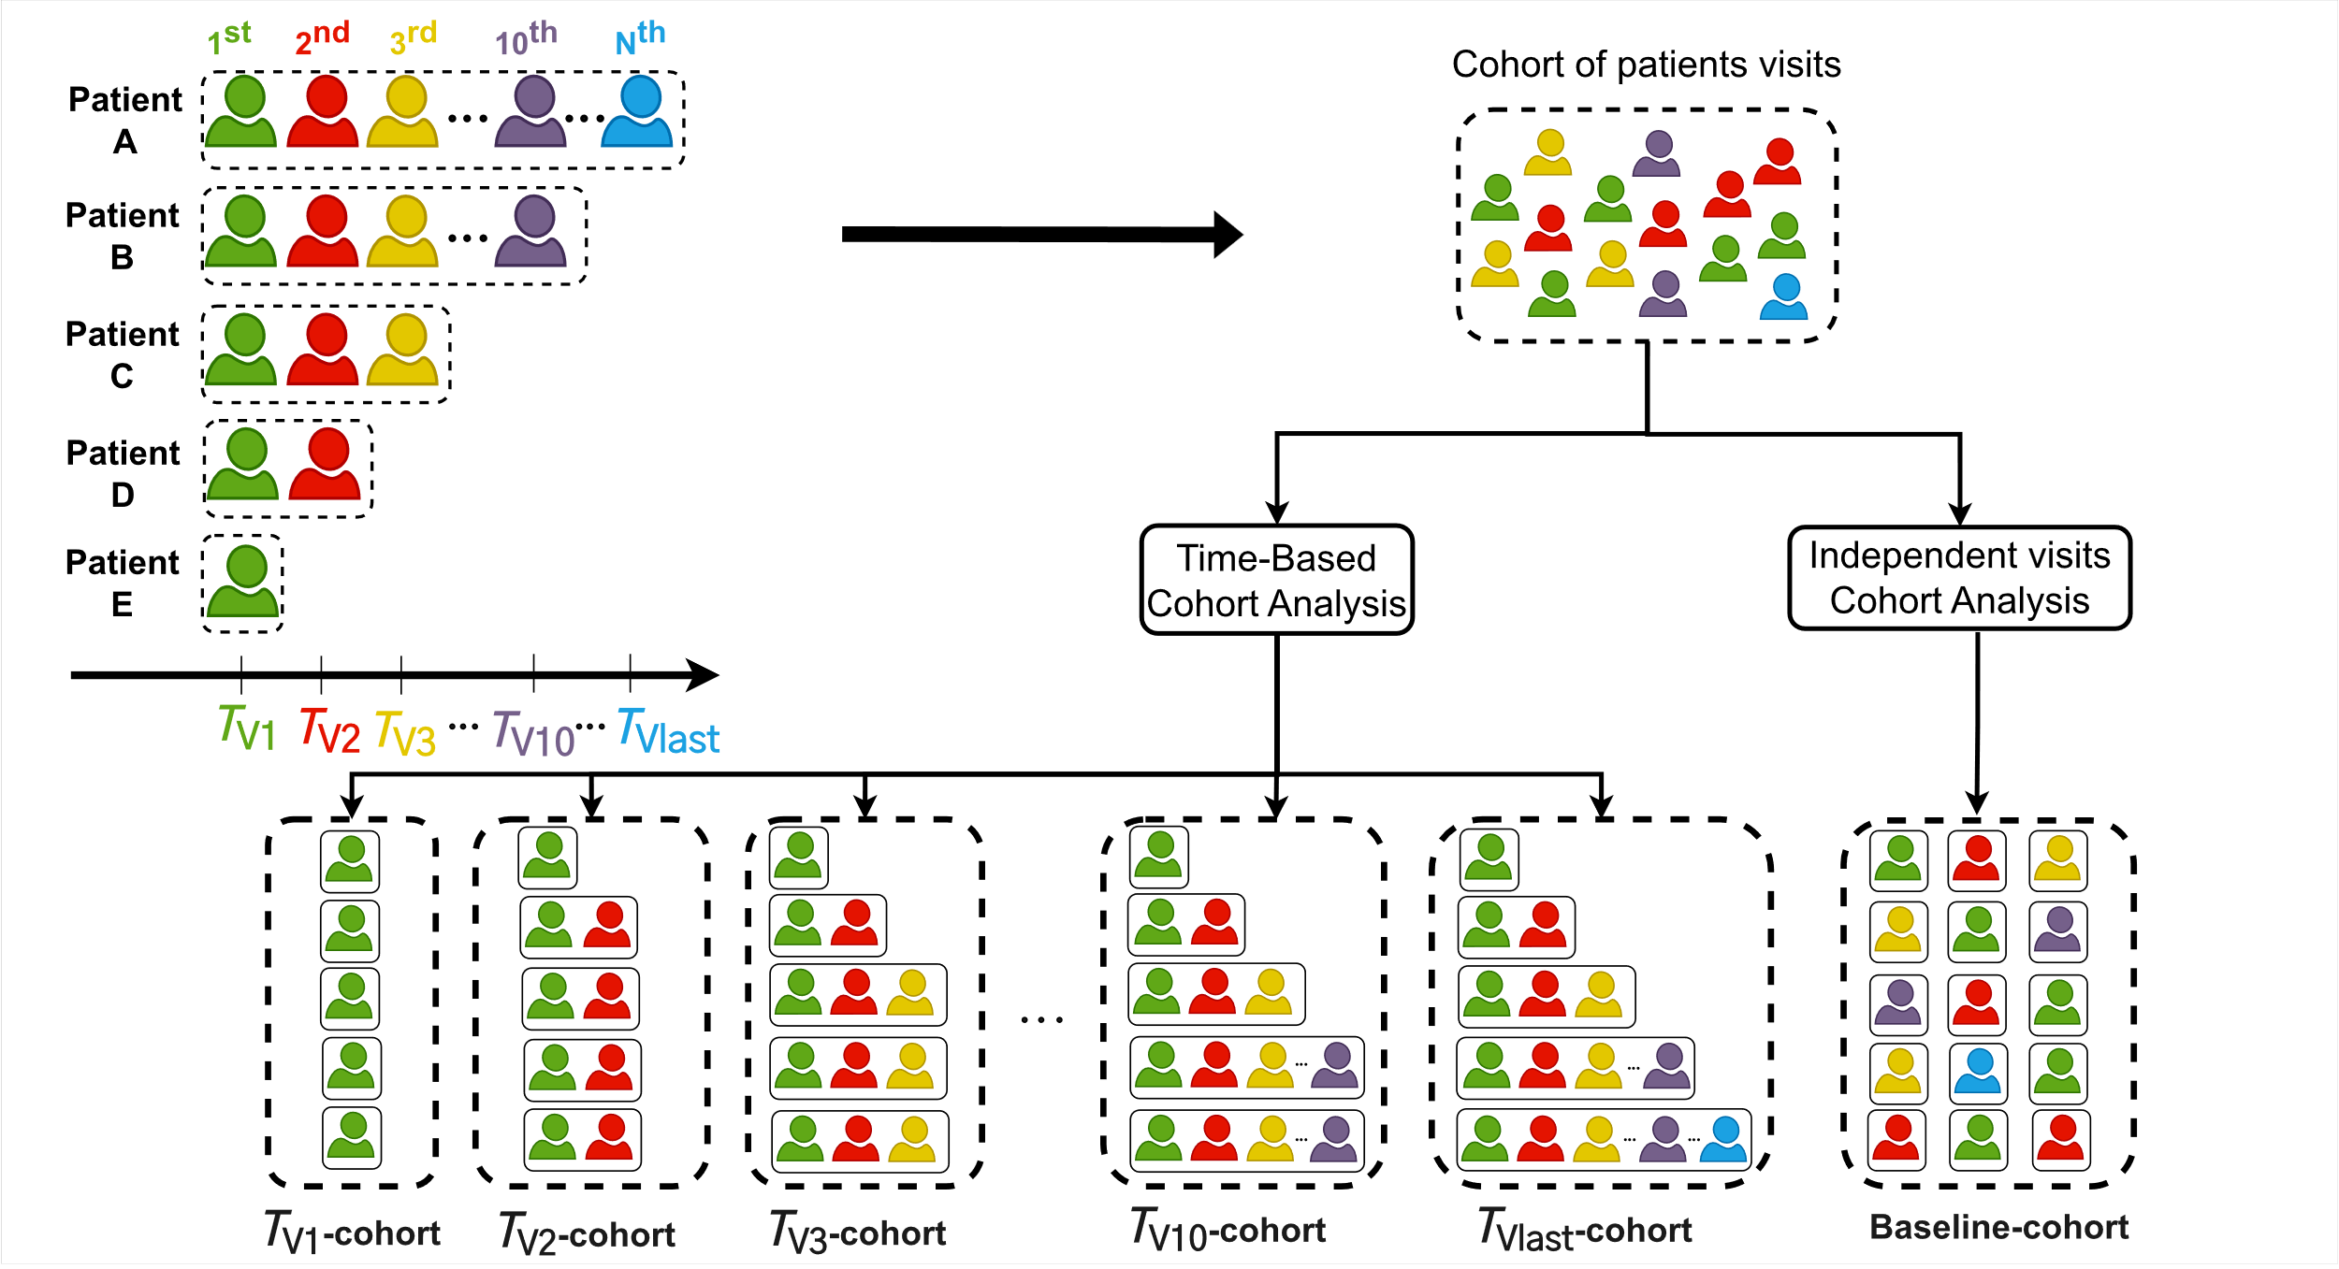
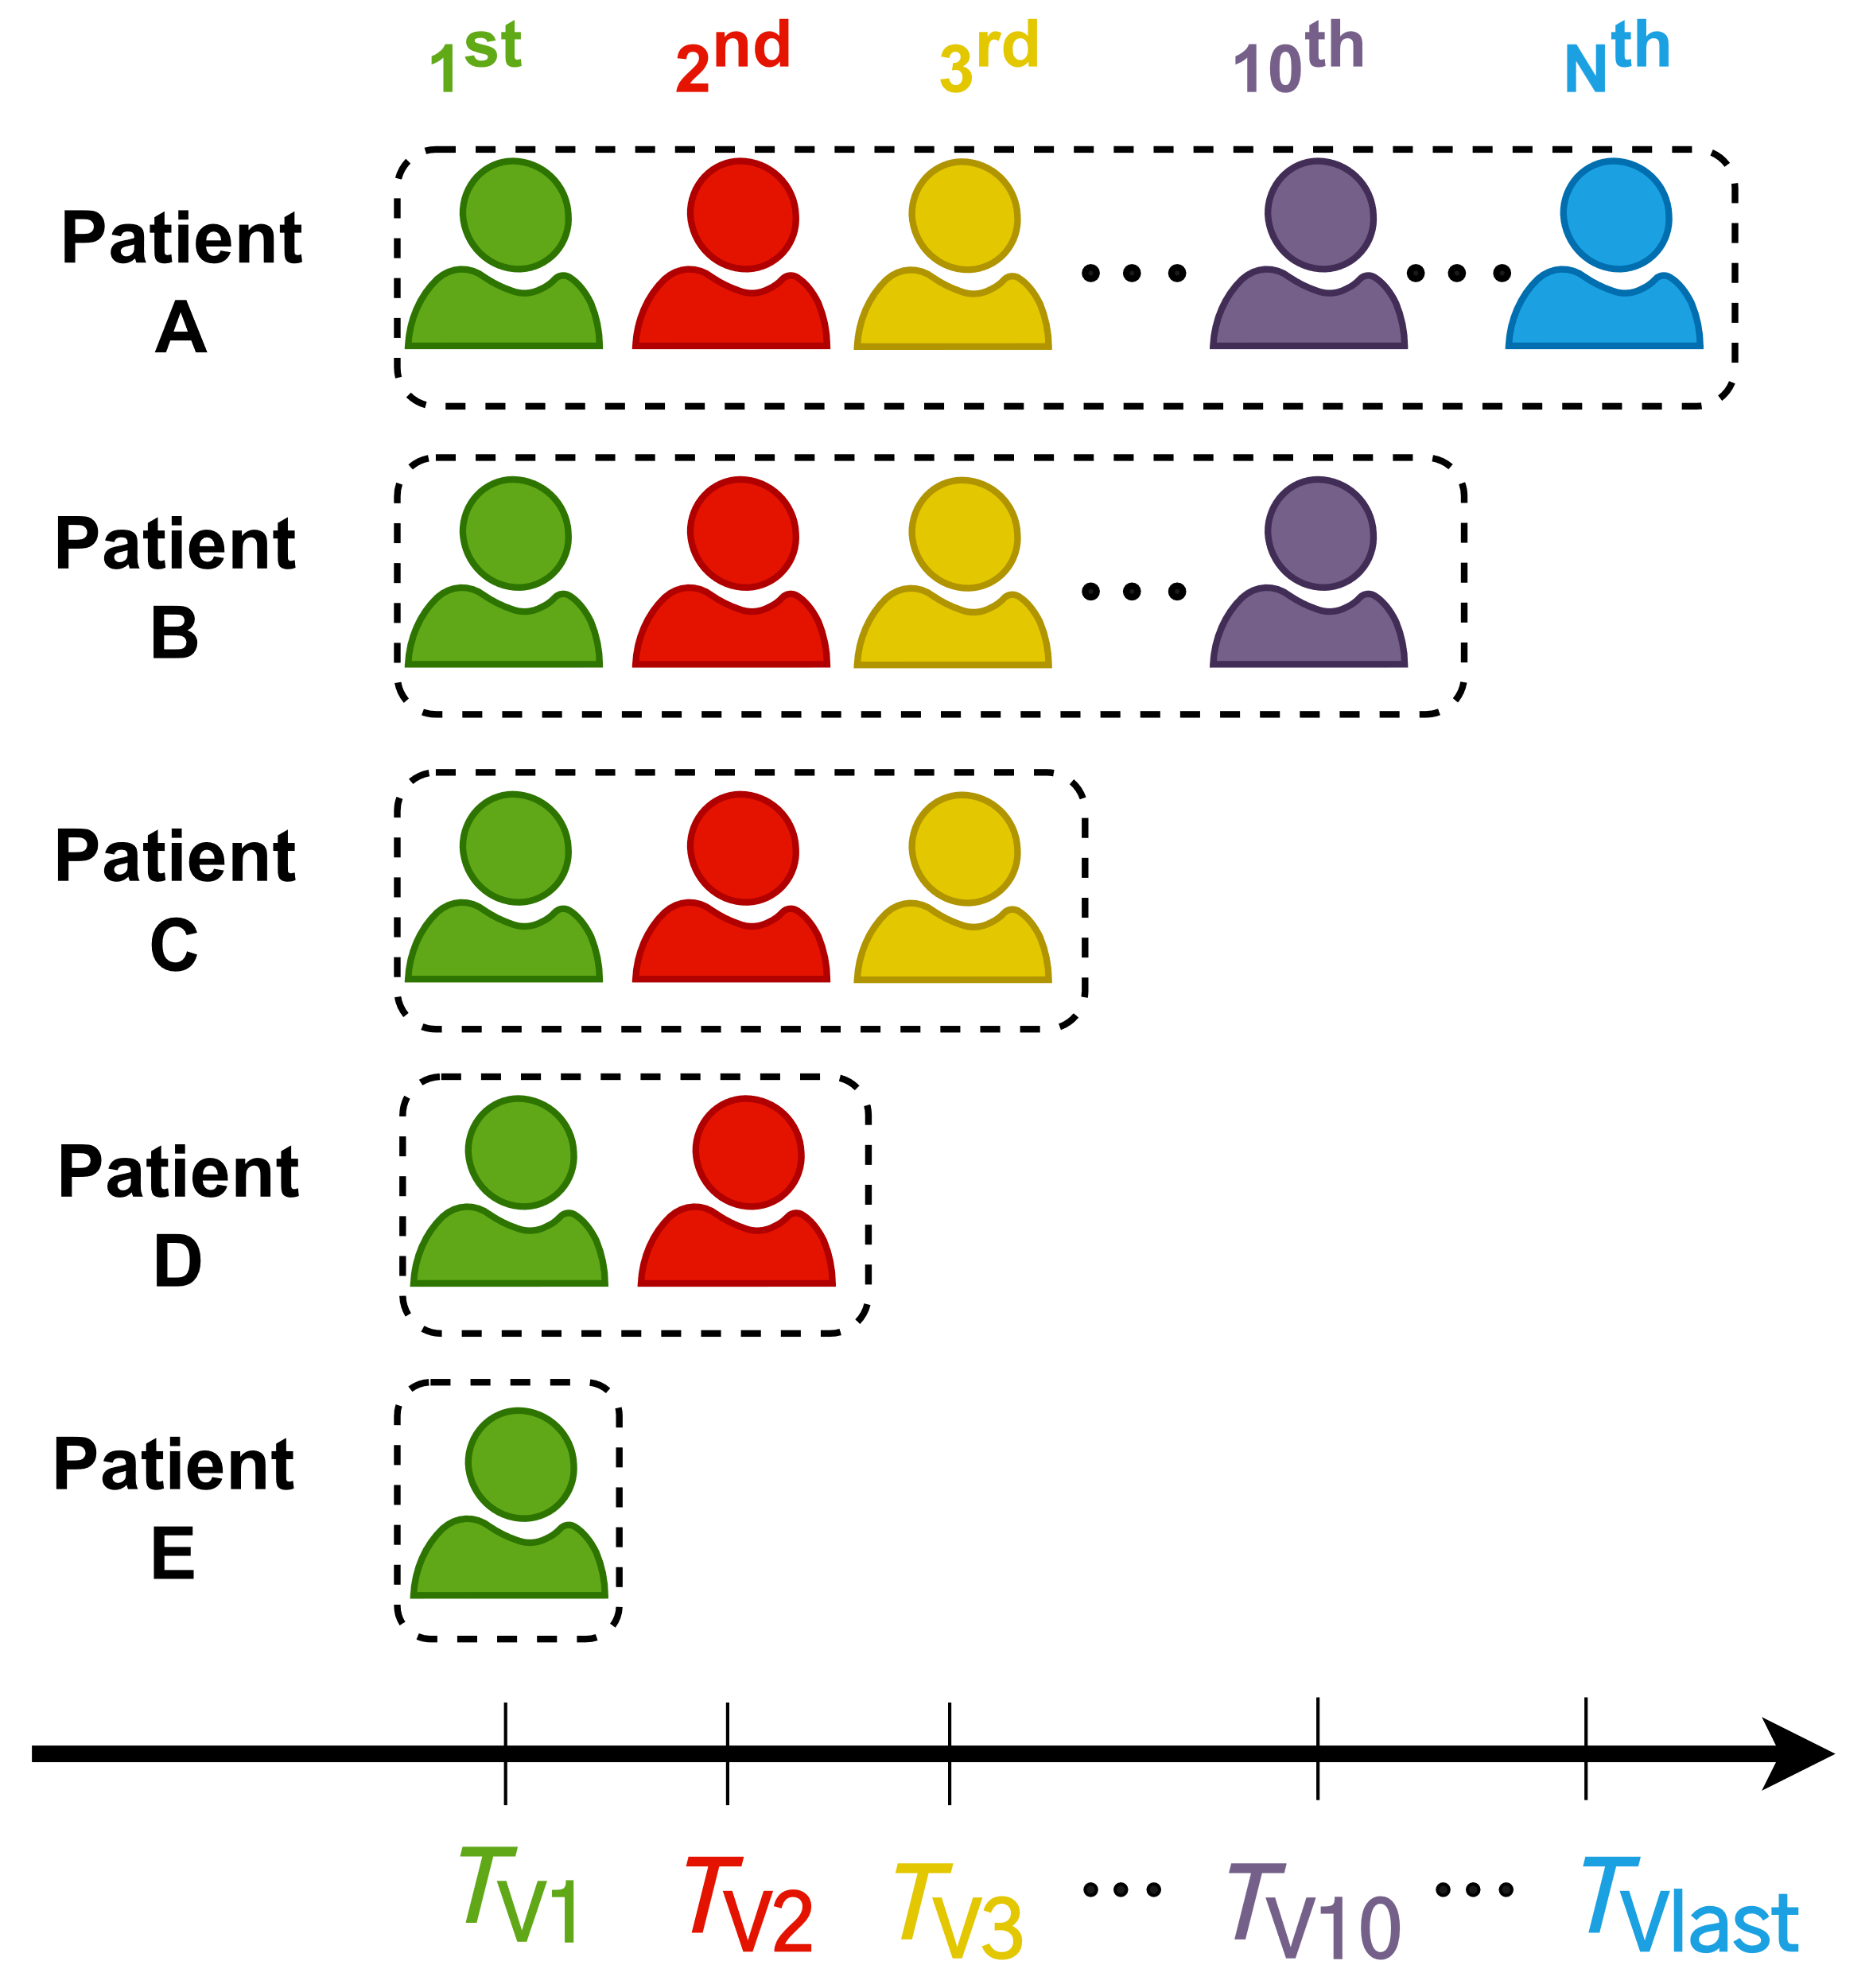
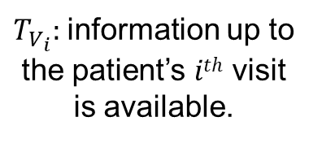
How to do the temporal analysis?
Our work
Previous work
$T_{V_{i}}:$information up to the patient’s $ith$ visit is available.
Relative timepoints

Slide 14


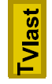


Model comparisons : One-year mortality Risk using AdmDemoDx
Mean AUC on 5 folds
RF
LSTM
* : p-value < 0.1
** : p-value < 0.05
*** : p-value < 0.001
Otherwise: p-value ≥ 0.1
DeLong test [X Sun et al., 2014] to compute p-values

Slide 15
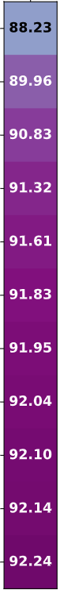
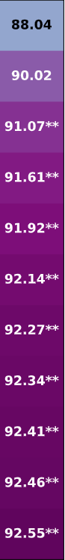
RF
LSTM
Significant improvement region where p-value < 0.05
Multiple testing cohorts

Slide 16
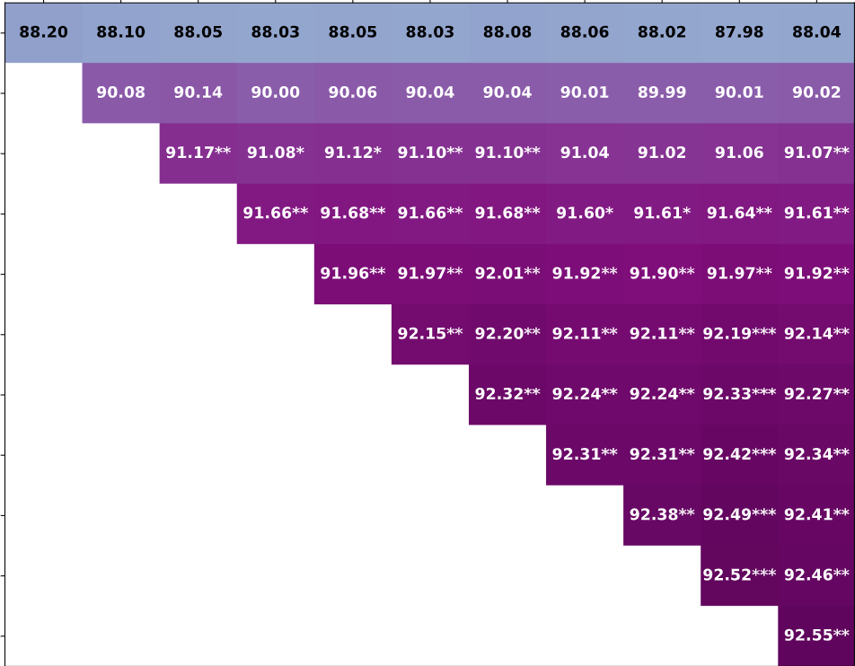
RF
LSTM

Slide 17
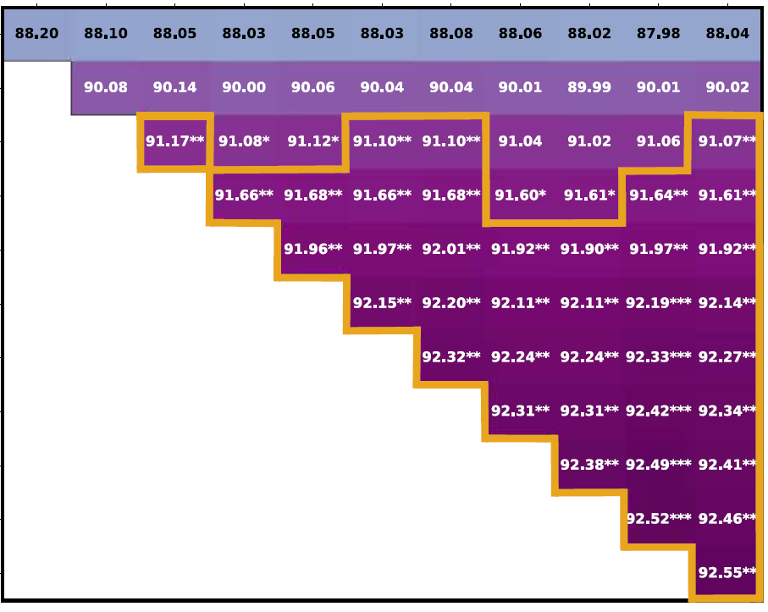
RF
LSTM
Multiple testing cohorts
Multiple testing cohorts
Multiple training cohorts
Multiple training cohorts
Significant improvement region where p-value < 0.05

Slide 18
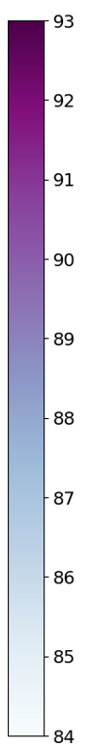
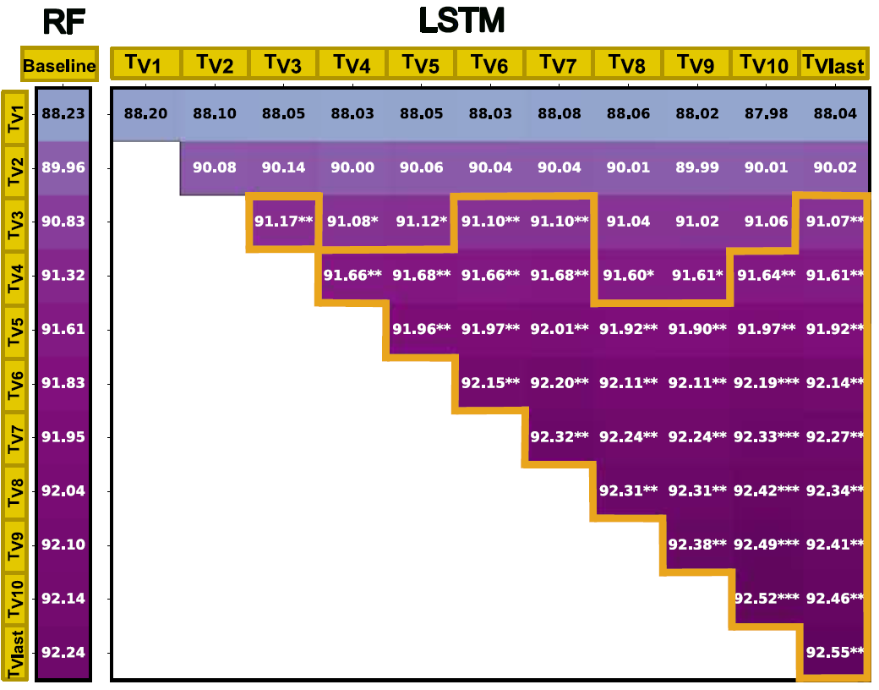
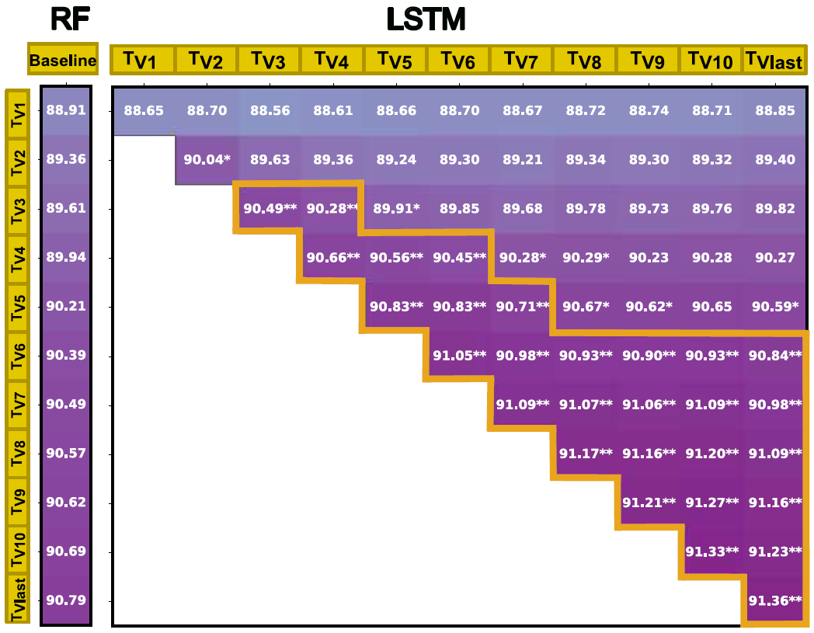
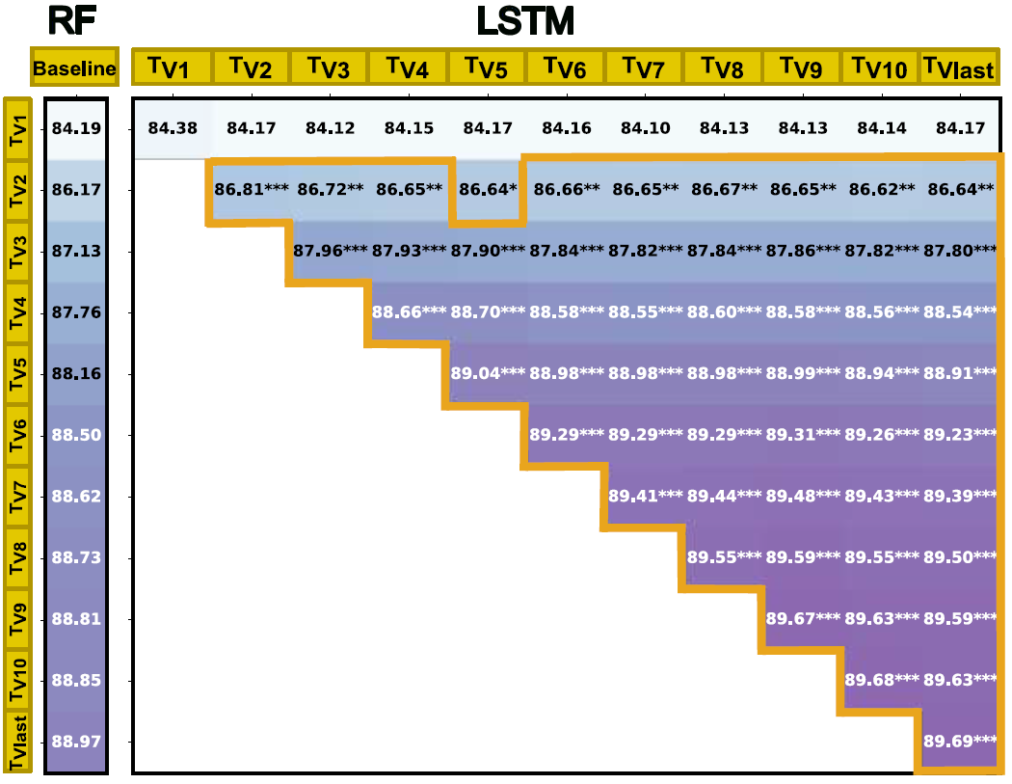
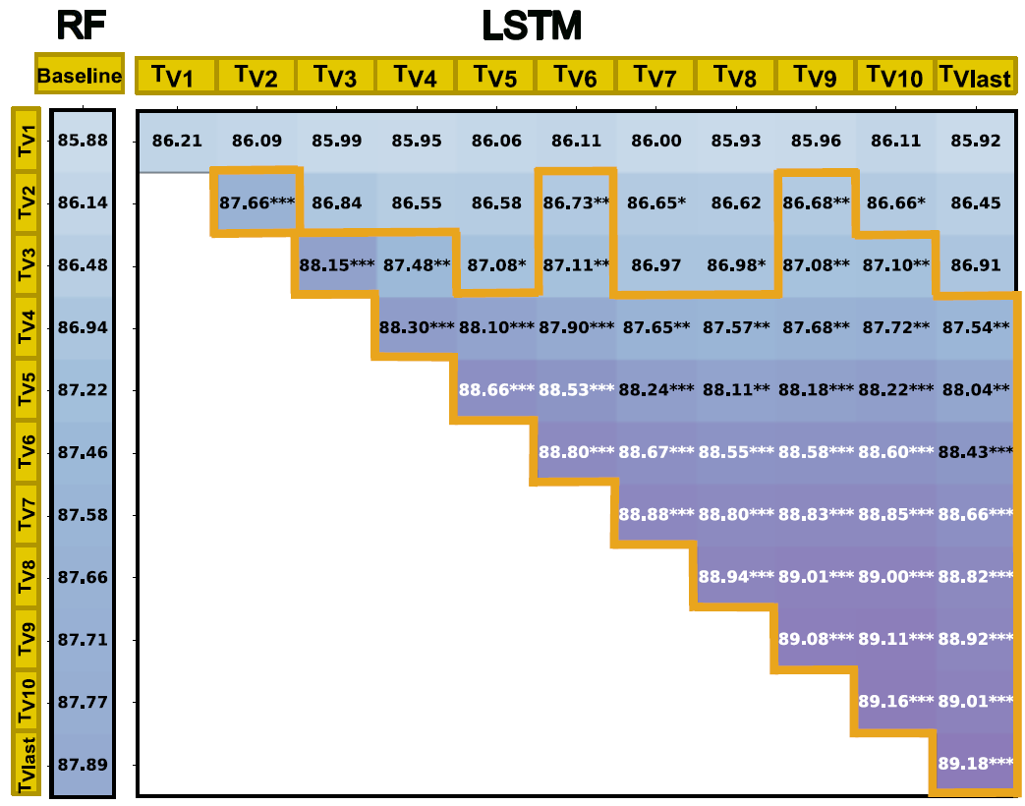
One-year Mortality
In-hospital Mortality
AdmDemoDx
AdmDemo

Slide 19
One-year Mortality
In-hospital Mortality
Significant regions where LSTM performs better than RF
AdmDemoDx
Considering patient’s longitudinal data improves prediction performance
AdmDemo

Slide 20
One-year Mortality
In-hospital Mortality
No significant regions in testing cohorts with few patient visits
AdmDemoDx
AdmDemo
Cohorts with few patient visits don't benefit from temporal aggregation

Slide 21
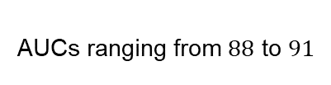
One-year Mortality
In-hospital Mortality
AdmDemoDx
AUCs ranging from $88$ to $91$
AdmDemo
Routine admission data effectively predicts in-hospital mortality

Slide 22
One-year Mortality
In-hospital Mortality
One-year Mortality
In-hospital Mortality
AdmDemoDx
AdmDemo
The selected predictive variables perform slightly better in predicting one-year mortality risk

Slide 23

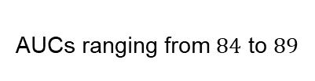
One-year Mortality
In-hospital Mortality
AdmDemoDx
AdmDemo
AdmDemoDx
Hospitals where diagnoses are encoded post-discharge can still benefit from an accurate model
AUCs ranging from $88$ to $92$
AUCs ranging from $84$ to $89$
AdmDemo
AdmDemo variables achieve good performances in predicting mortality prediction

Slide 24
Final testing
RF vs LSTM?
LSTM
Development phase
Deployment phase

Slide 25
When diagnoses variables are available
Patient’s admission
Patient’s discharge
One year later
In-hospital Mortality
One-year Mortality
85.50
86.61
Otherwise
Patient’s admission
Patient’s discharge
One year later
In-hospital Mortality
One-year Mortality
82.93
82.47

Slide 26
To summarize:
Temporal analysis of patient’s longitudinal data improves prediction accuracy¸.
Routine admission data can effectively predict in-hospital mortality.
AdmDemo variables achieve good performances in predicting mortality risk, especially when aggregating patient’s history.

Slide 27
questions ?

Slide 28
Holdout set
 | One-year Mortality | In-hospital Mortality
AdmDemoDx | 89.14 | 89.03
AdmDemo | 85.88 | 87.07
CDSS-eligible set
Deployment mode
 | One-year Mortality | In-hospital Mortality
AdmDemoDx | 86.61 | 85.50
AdmDemo | 82.47 | 82.93
The CDSS set yielded lower results as expected, given its exclusion of patients from obstetrics and palliative care, which are associated with clearly defined outcomes

Slide 29
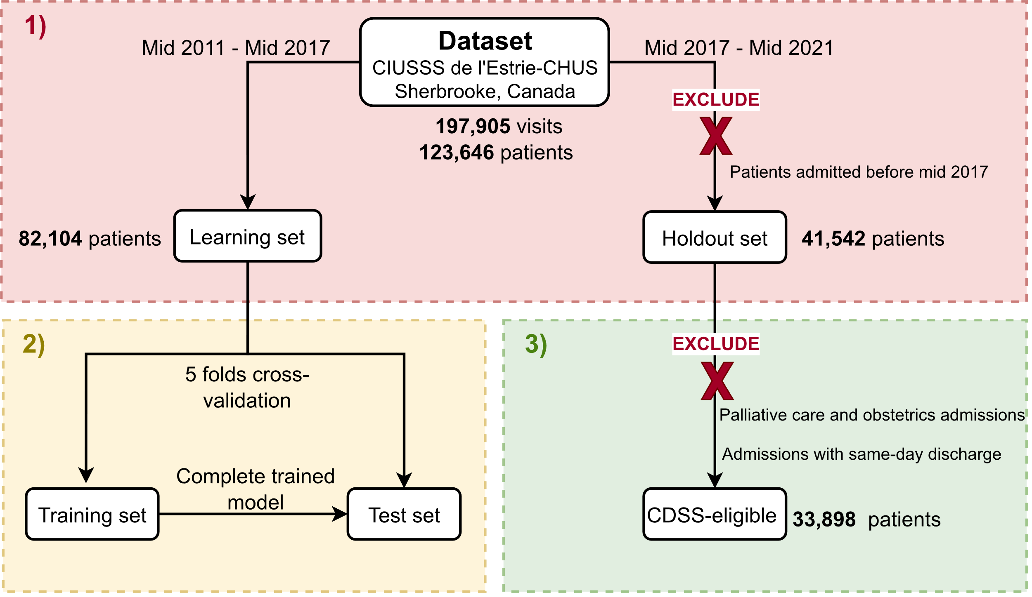
Validation phase
Final testing
RF vs LSTM?
LSTM
Development phase
Deployment phase

Slide 30
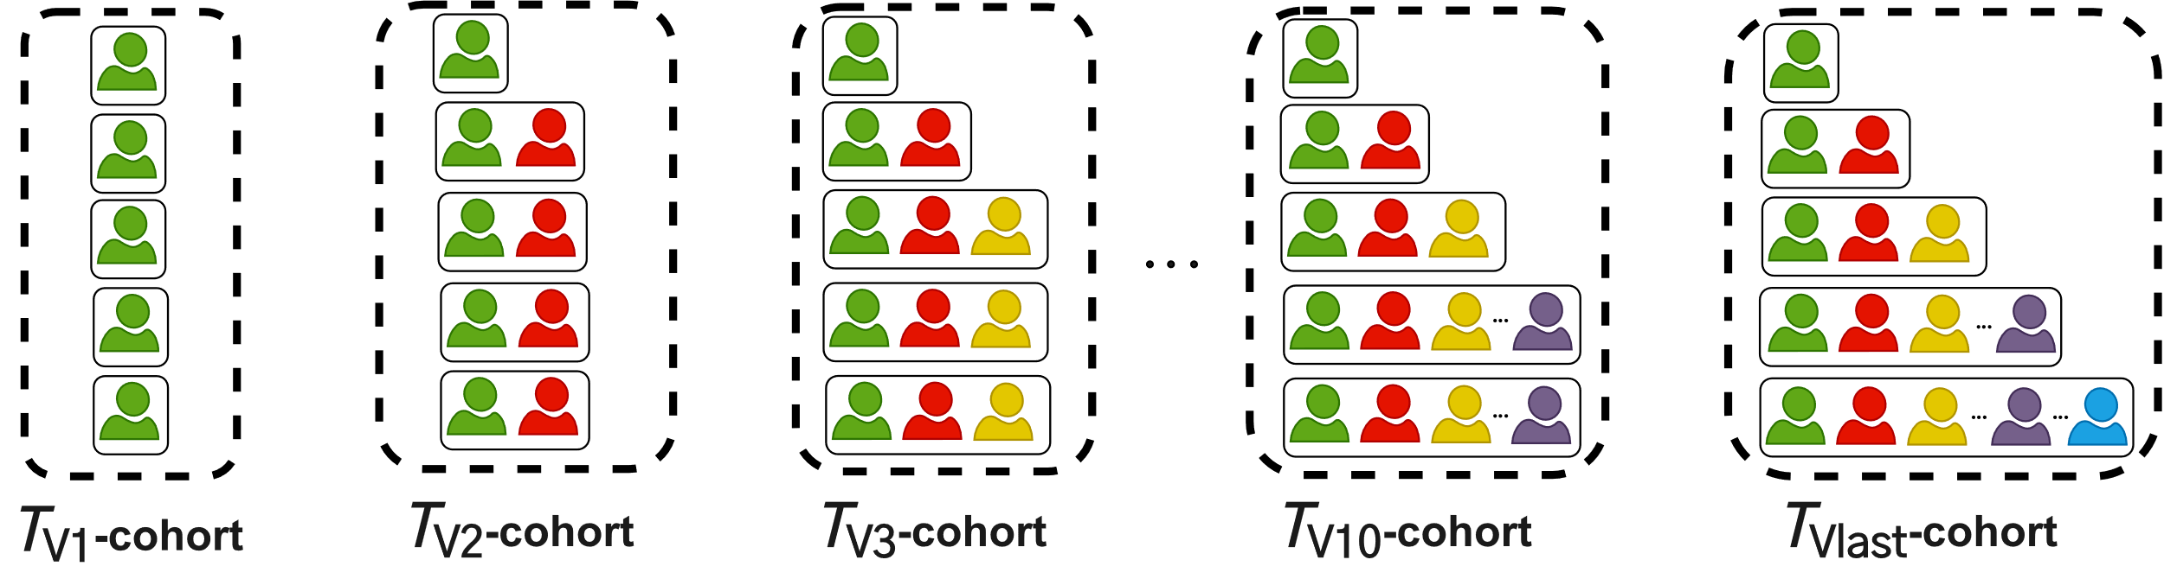
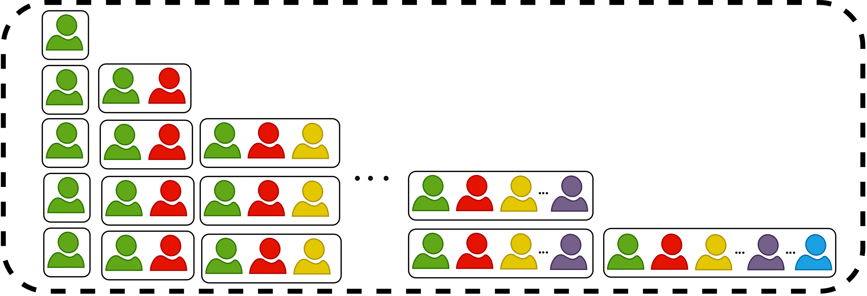




Create the final testing cohort
Final testing cohort
$$∪$$
$$∪$$
$$∪$$
$$∪$$
Prediction at every patient’s visit
Using patient’s history
How the model performs at all patient stages
Notes:
However now we need a final temporal testing cohort, and for that we will do a union of these simulated cohort to make a prediction at every patient’s visit, the goal is to see how the model performs att all patients stages

Slide 31
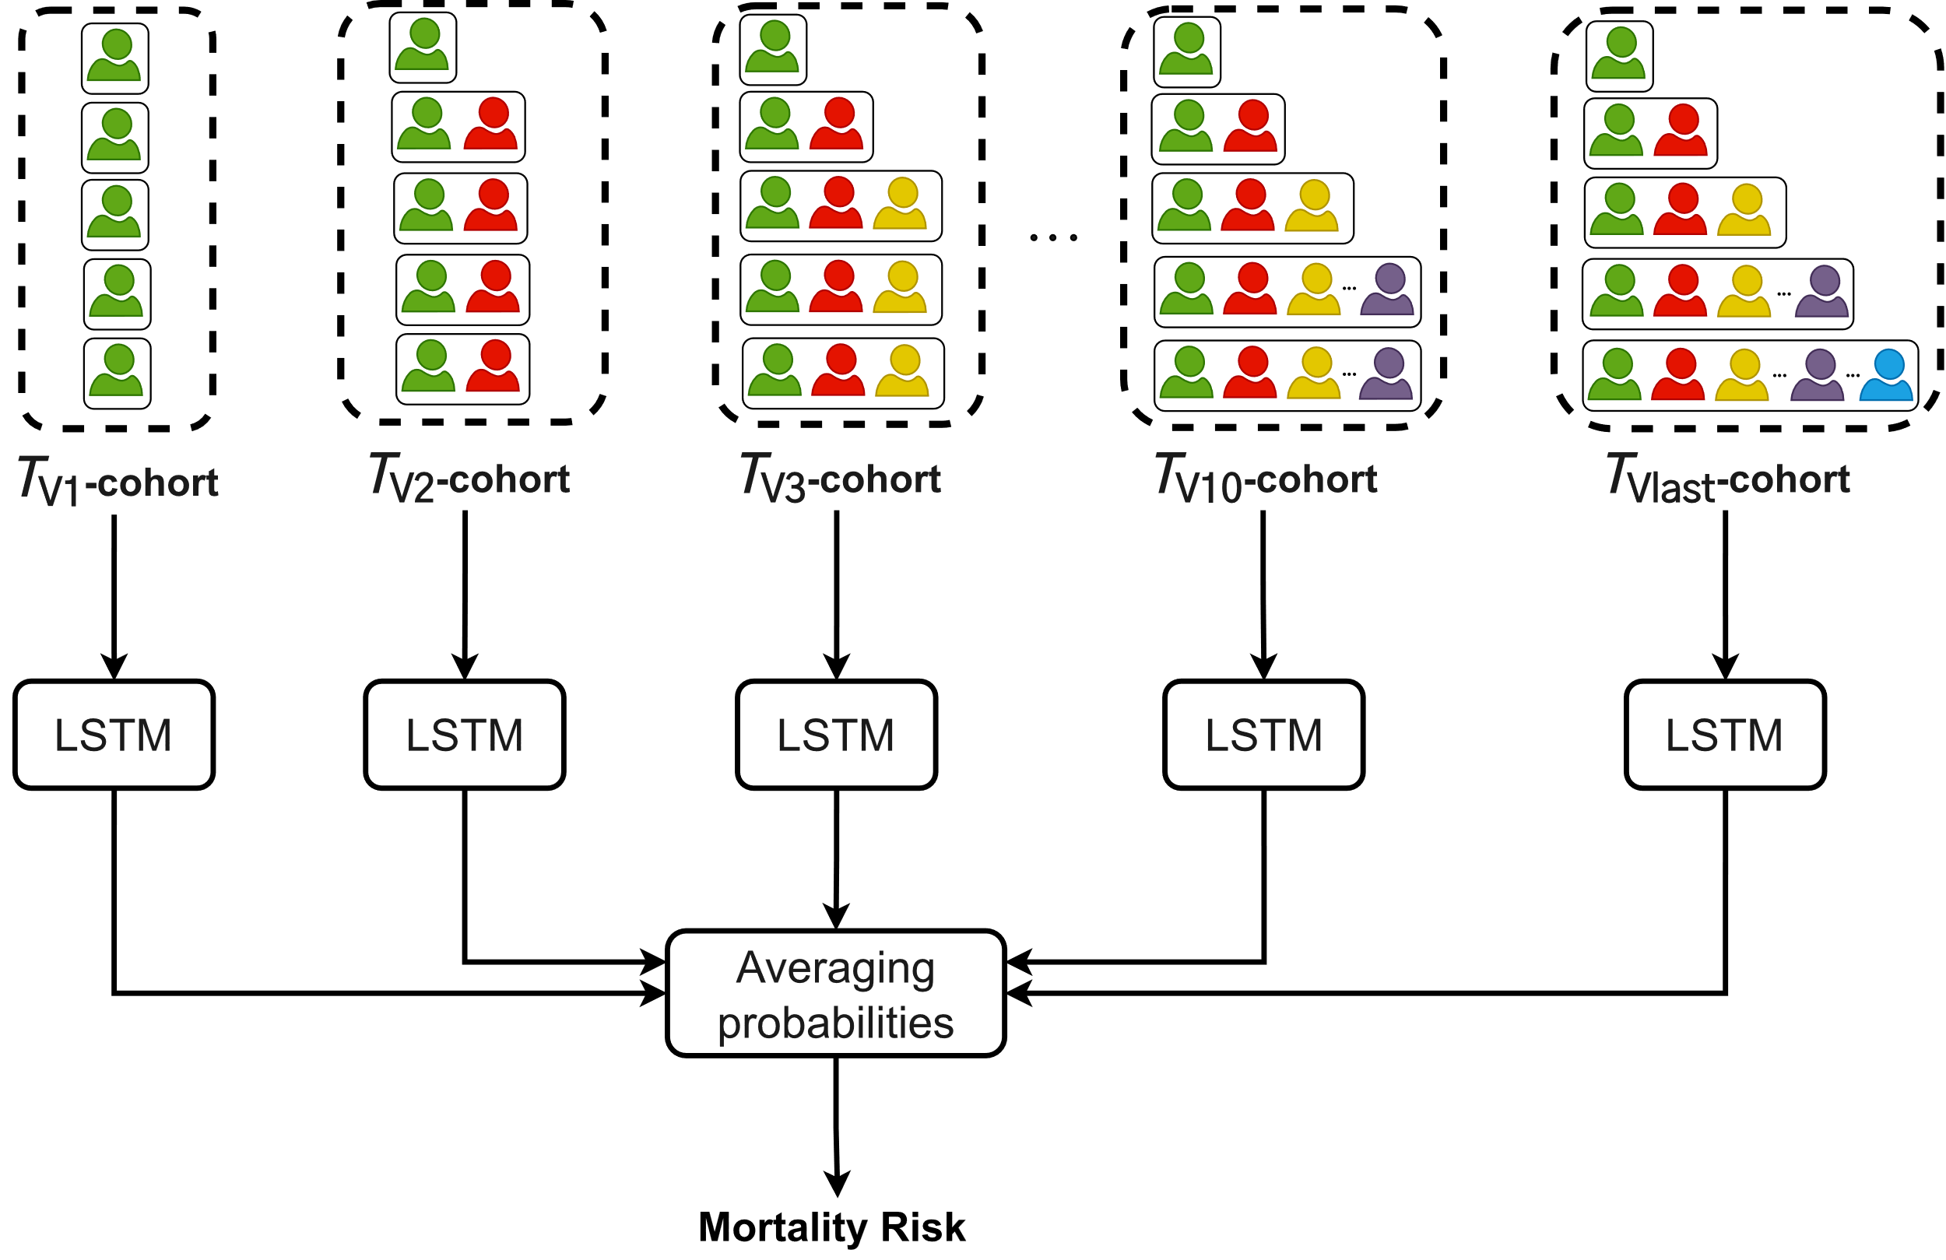
Create the final model
Train multiple LSTMs with different cohorts
Create an Ensemble Model
Notes:
The same way, our final model is an ensemble model that averages each prediction made by an LSTM trained with a specific temporal cohort

